Slide 1
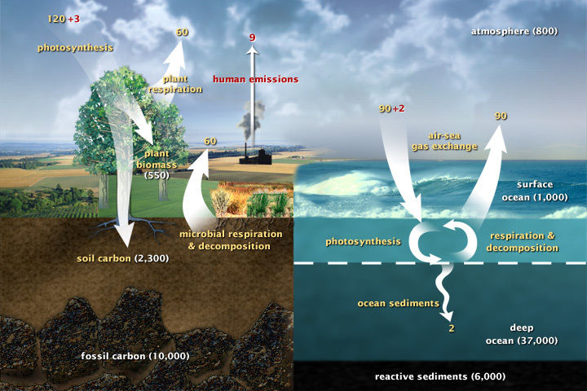
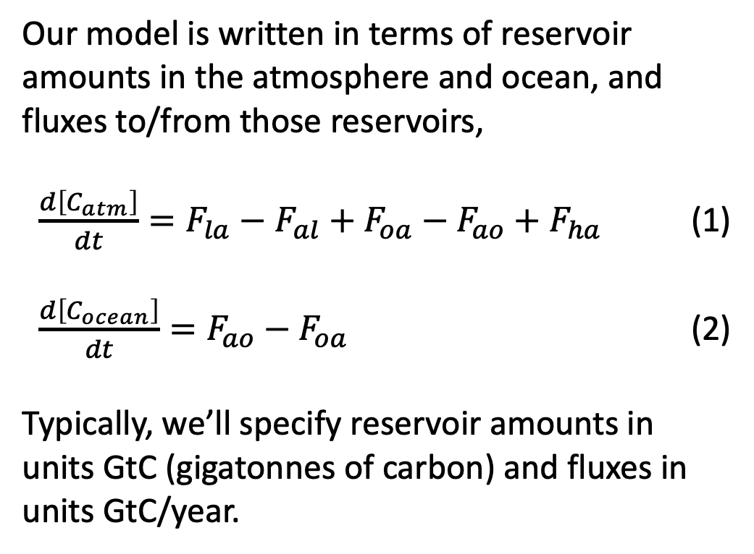
The basic Cambio model
Our model is written in terms of reservoir amounts in the atmosphere and ocean, and fluxes to/from those reservoirs,
$\frac{d\left[C_{atm}\right]}{dt}=F_{la}−F_{al}+F_{oa}−F_{ao}+F_{ha}$ (1)
$\frac{d\left[C_{ocean}\right]}{dt}=F_{ao}−F_{oa}$ (2)
Typically, we’ll specify reservoir amounts in units GtC (gigatonnes of carbon) and fluxes in units GtC/year.

Slide 2
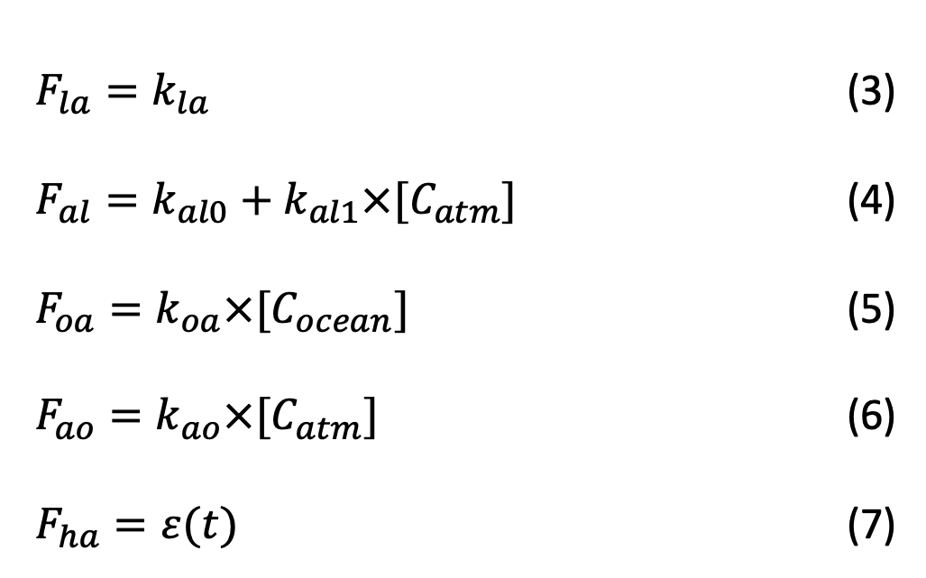
Carbon fluxes
In the simplest version of the model, Cambio 1.0, the fluxes are given by
$F_{la}=k_{la}$ (3)
$F_{al}=k_{al0}+k_{al1}×[C_{atm}]$ (4)
$F_{oa}=k_{oa}×[C_{ocean}]$ (5)
$F_{ao}=k_{ao}×[C_{atm}]$ (6)
$F_{ha}=ε(t)$ (7)

Slide 3
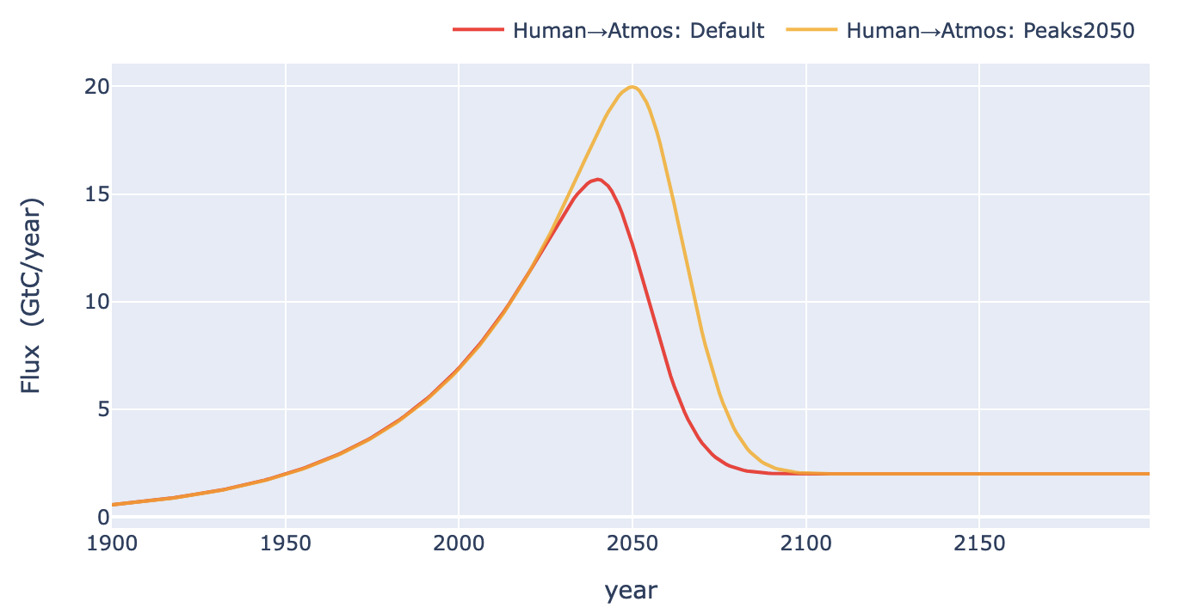
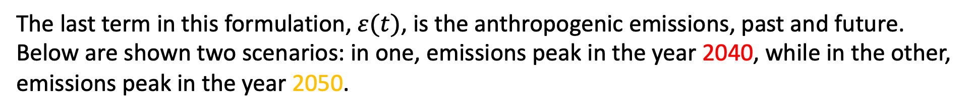
The expected anthropogenic emissions, 𝜀(𝑡)
The last term in this formulation, $ε(t)$, is the anthropogenic emissions, past and future. Below are shown two scenarios: in one, emissions peak in the year 2040, while in the other, emissions peak in the year 2050.

Slide 4
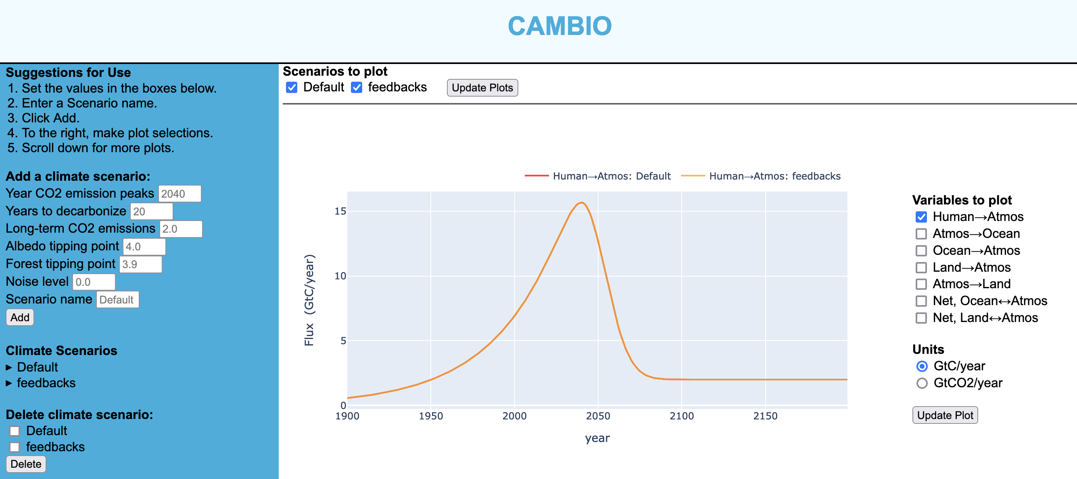
The expected anthropogenic emissions, 𝜀(𝑡)
Your goal …
Adjust the year at which CO2 emission peaks such that we emit as much as we possibly can, but still stay under 2 degrees warming.
Run that scenario again with tipping points crossed at 2 degrees warming.

Slide 5
OK, let’s get started!
There’s a short CGI, Week_03a.ConcentrationAndFlux, to help get you oriented.
Then we’ll dive into the web version of Cambio, at https://cambio.fly.dev/.

